Slide 1
AVR Radar
By Jake D. Karas

Slide 2
The Project and Purpose
Detects the presence objects within a certain radius of itself
Common examples:
Vehicles
Animals
Weather
Outputs a wave towards objects around itself, then receives the wave back as an input
Longer return time = further object

Slide 3
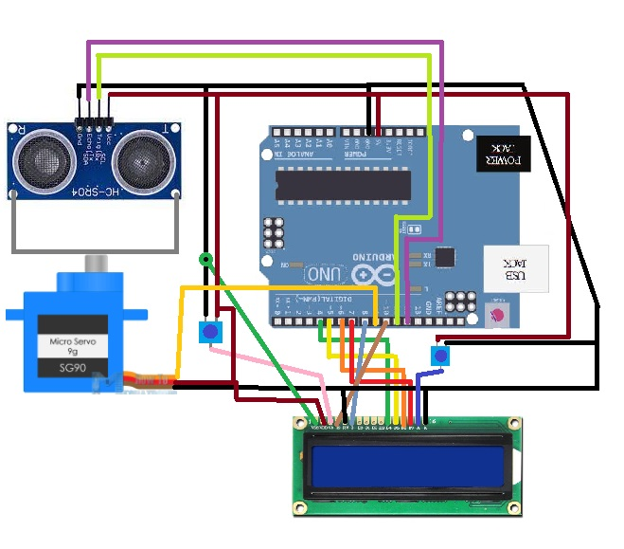
Circuit Diagram

Slide 4
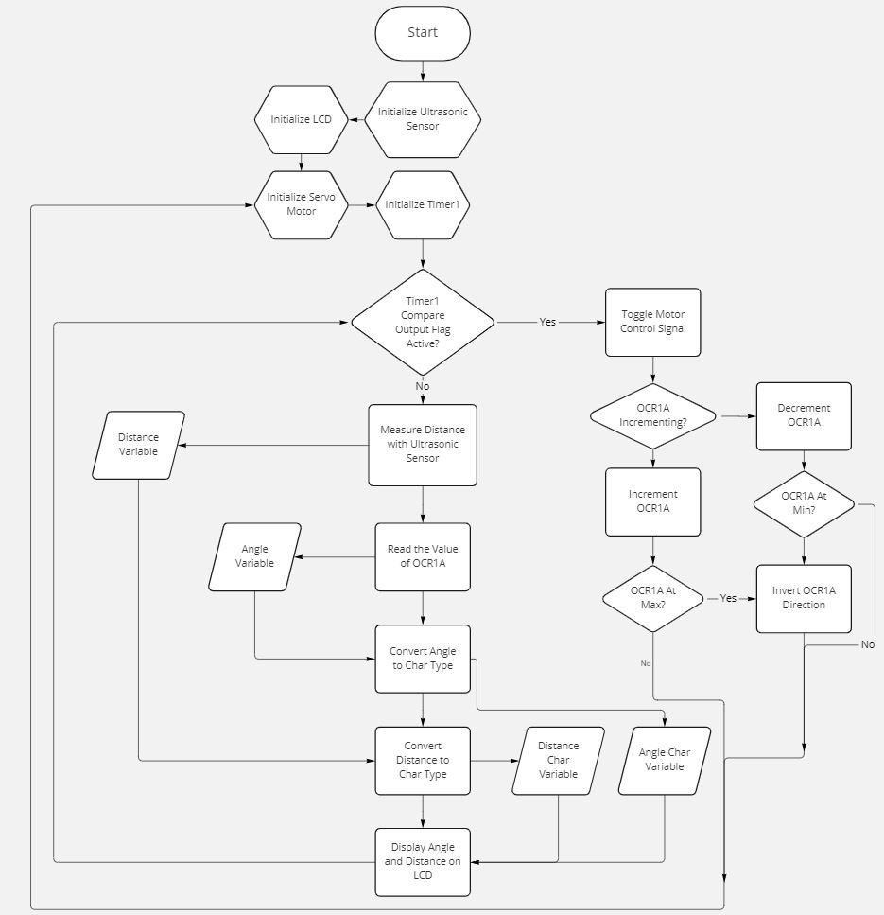
Program Flow Chart

Slide 5
Program Callouts
OCR1A goes up and down, switching direction at 7000 and 39000
Pulse width affected
Servo position controlled
Utilizes CTC interrupt
Sprintf() converts OCR1A to a char while itoa() does so for the distance
Makes them printable on the LCD

Slide 6

Demo Video

Slide 7
Issues Encountered
Fixing one piece of the program broke other parts, typically due to memory overuse
Using sprintf twice
Main function failing
Tasks overriding each other
Fixed with motor on interrupts

Slide 8
Lessons Learned
When in doubt, consult the internet
AVR forums and resources in particular
Don’t use the same technique twice
Evident by memory issues with sprintf twice in a row

Slide 9
Reference:
https://www.britannica.com/technology/radar

